Slide 1
ROLE MODEL MIRAGE APP
Empowering & motivating visually impaired people

Slide 2
Table of the content
Introduction
Problem Statement
Key features of app
Solution proposed
Complete Process
Conclusion

Slide 3
Introduction
In the dynamic landscape of STEM, the absence of visually impaired role models poses a significant challenge, thwarting the aspirations of visually impaired students and limiting their career possibilities. Enter Role Model Mirage, a groundbreaking initiative set to shatter these barriers. Focused on fostering representation, this project aims to create an online platform that magnifies the stories and journeys of triumphant role
TEAM NAME: MATRIX LEADER: V DANUSH
TEAM MEMBERS:
TARA MRITHULA R
SANDIYA C
PRAGADEESH M
PADMASHRI P

Slide 4

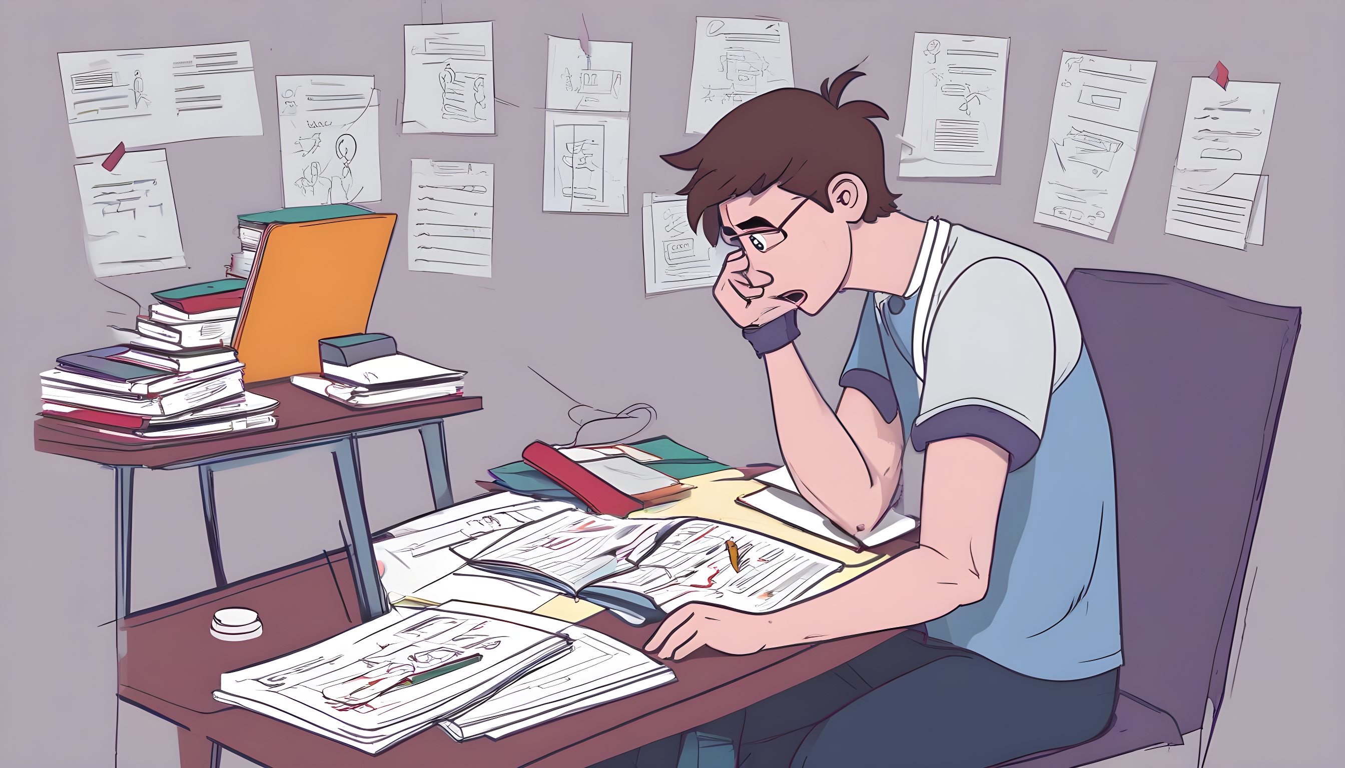
PROBLEM WE ARE ADRESSING:
Many visually impaired students who dream of careers in science, technology, engineering, and math (STEM) face a tough challenge—they don't see people like them succeeding in these fields. This lack of role models makes it hard for them to imagine themselves having successful STEM careers. To tackle this problem, we want to create Role Model Mirage, an online space where successful visually impaired individuals in STEM share their stories.

Slide 5
THE CENTRAL ISSUES
AN ONLINE PLATFORM SHOWCASING STORIES AND JOURNEY OF SUCCESS ROLE
MENTORSHIP PROGRAMS,PEER TO PEER CONVERSATIONS FOR GUIDANCE AND NETWORK GLOBALLY.

Slide 6



KEY FEATURES OF THE APP
Authentication and navigation using voice assisstance
Providing voice chat,text to audio,audio to text features
SIMPLE UI
DISCUSSION FORUMS
CUSTOMIZED AUDIO BOOKS
Audio books with acoustic sounds for better feel
03

Slide 7

STAGES IN THE APP
Stage 1
Stage 3
Stage 1
LOGIN
Discussion forums and uploading certificates
login using voice assistance and navigation in app through signs,taps and swipe.Simple navigation
Discussion forums where voice chat,text to audio audio to text features can b done.uploading files via voice assisstance
Stage 2
Analysis
Creating audiobooks with acoustic sounds.Making them to feel the content

Slide 8
COMPLETE PROCESS
Choosing the preferred STEM portfolio and navigation using taps and swipe
Discussion forums with voice chat feature.Text to audio for end uders and audio to text for HR if preferred
Login through simple UI and navigate using voice assisstance
Customized audiobooks where acoustics sounds are involved
Uploading documents using voice assistance.

Slide 9

SCOPE FOR IMPROVEMENT
Building a fully functionable app that benefits visually impaired people by motivating them by creating audio books of the successful visually challenged people
Efficient filtering process for HR department which recruits skilled people who are visually challenged.
Voice chat discussion forums
Acoustic sounds in audio
The whole motive is to motivate visually challenged people. So, filtering HR is preferred as rejections make them feel different from others

Slide 10
Conclusion
In conclusion, Role Model Mirage endeavors to bridge the gap and inspire visually impaired students pursuing STEM careers. By addressing the challenge of limited representation, we strive to empower individuals to envision and achieve their aspirations in these fields. The app not only showcases success stories but also fosters a supportive community through mentorship and global networking. Through these efforts, we aim to transform the landscape of STEM for visually impaired individuals, fostering inclusivity and opening doors to a future where everyone, regardless of visual abilities, can thrive in the exciting world of science and technology.

